Slide 1



Slide 2
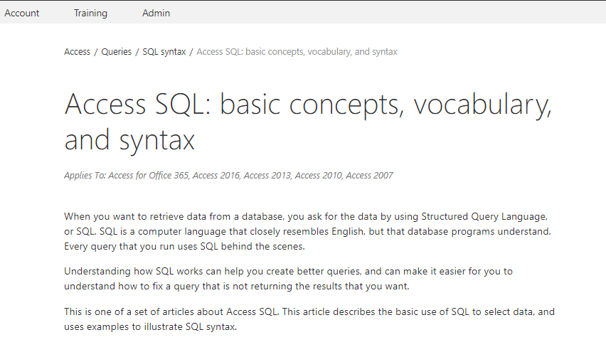
https://support.office.com/en-us/article/access-sql-basic-concepts-vocabulary-and-syntax-444d0303-cde1-424e-9a74-e8dc3e460671

Slide 3
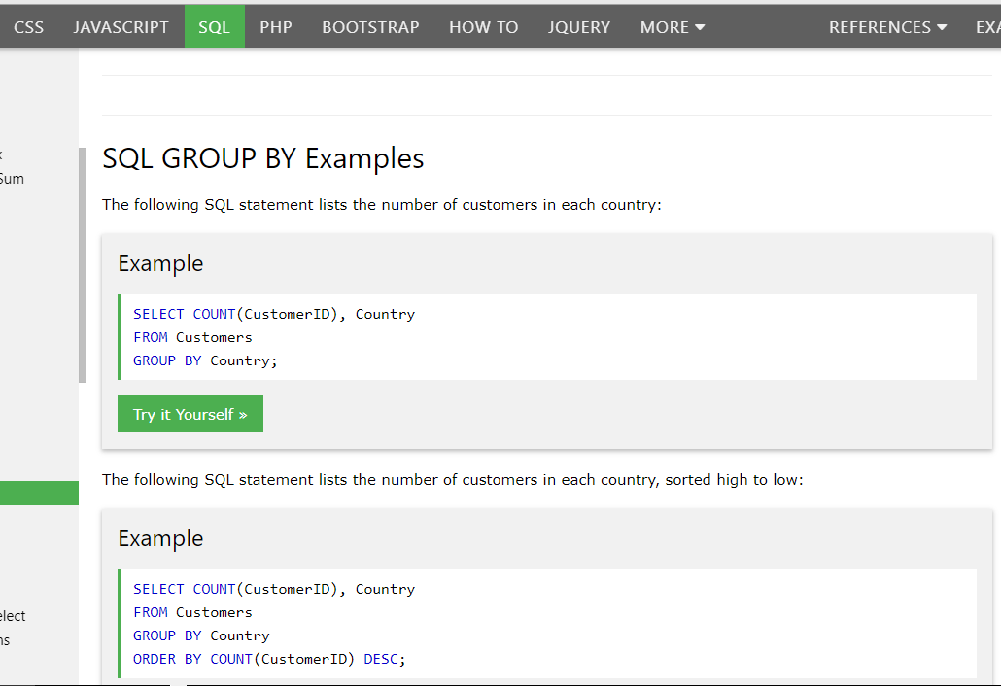

Slide 4
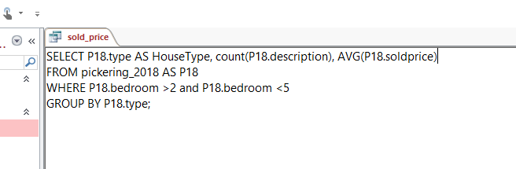
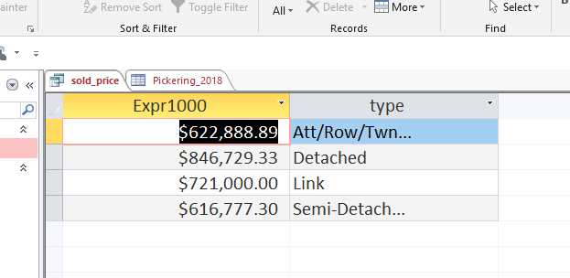
Column Alias, Aggregate Functions, Group By

Slide 5
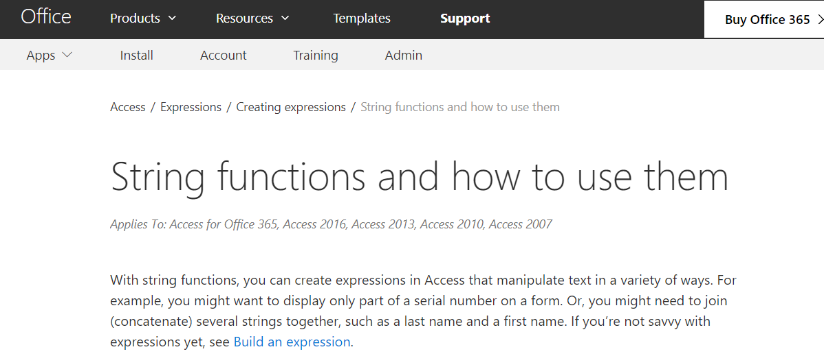
Working with TEXT
https://support.office.com/en-us/article/string-functions-and-how-to-use-them-965efa84-7009-4603-9765-2eb4a099ec72

Slide 6
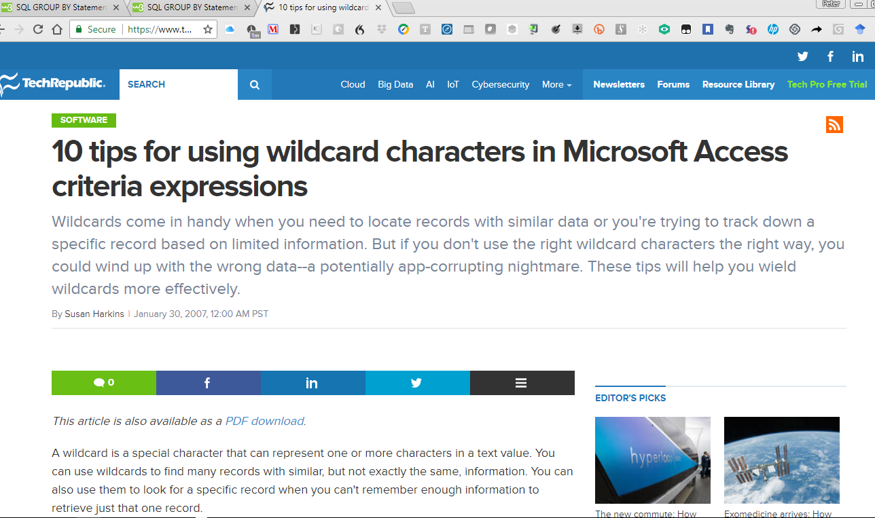
https://www.techrepublic.com/article/10-tips-for-using-wildcard-characters-in-microsoft-access-criteria-expressions/

Slide 7
Developing the bicycle shop database

Slide 8
The requirement
You have been hired by a bicycle repair shop to create a Database to keep track of the details of customers who:
(1) Purchase a Bicycle [and are therefore entitled to free lifetime repairs], and
(2) customers who bring their Bicycle in to be repaired (for a $25/hour fee + cost of parts).
The Database Shall provide a data structure to store: customer information, bicycle information, and any other relator tables you need to put into your design to make the SQL relationships work

Slide 9
The requirement
Sketch the design for your Relational Database system with the necessary tables to make the above-stated requirement work.
State all fields in each table: Field Data types must be specified correctly.
Remember to identify your Primary keys.

Slide 10

Some important points
Remember that for Bicycle Repairs, you must state whether the Repair is WARRENTY or BILLABLE.
People who bought a bicycle from the shop have free lifetime repairs. Walk In Customers are charged $25/hour.
You will have to use LEFT, RIGHT, INNER and OUTER joins in the course of getting all your work done.

Slide 11

Deliverable requirements
A Microsoft Access Database with data-populated tables
You might find it easier to write the data in the form of spreadsheets and import it
Write 3 SQL Statements:
Generate a Report on all customers including bicycles they have purchased or brought in for repair
Generate a Report on all Bicycles purchased or brought in for repair.
Generate a Report on the activities of the Repair Department: How many bicycles they have repaired, time spent, and revenue generated

Slide 12
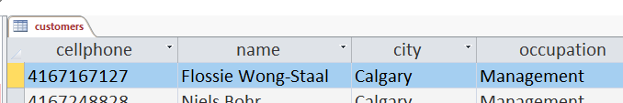
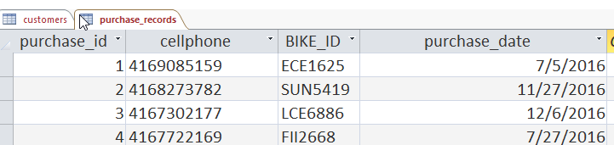
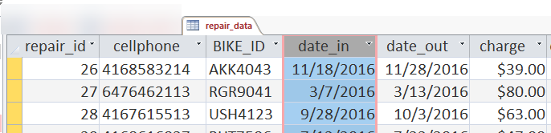
Deliverable requirements
Your database must have (at least) these tables and fields for my automated tests to work: [You may need more tables to meet the requirements of the Client]

Slide 13
Project delivery notes:
You will be using your class time for Weeks 11, 12, and 13
On Week 14 we will do Test 2 in class. The contents of Test 2 will mirror very closely the skills of the Project.
We will be spending some time in class to learn some additional SQL Formulations:
Group By and HAVING
Aggregation Functions
Inner, outer, left and right joins

Slide 14
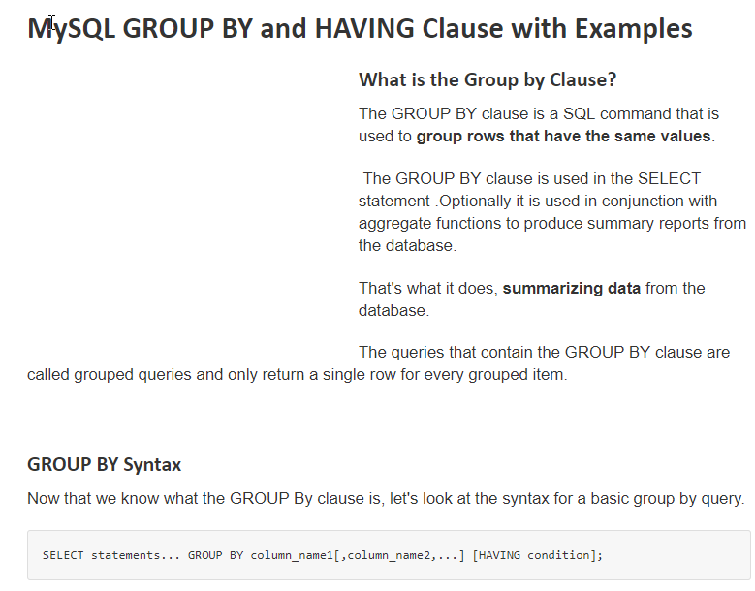
Notes:
https://www.guru99.com/group-by.html

Slide 15


Slide 16
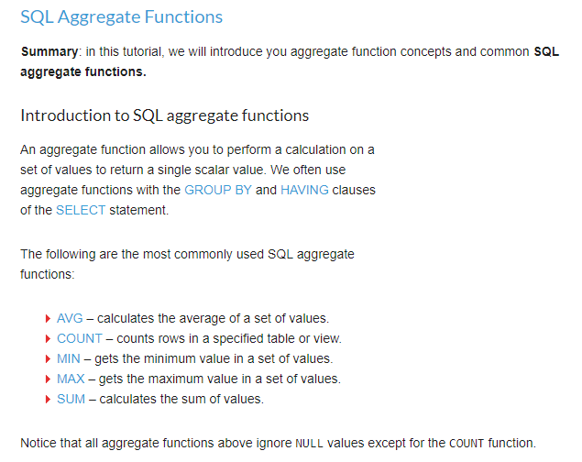
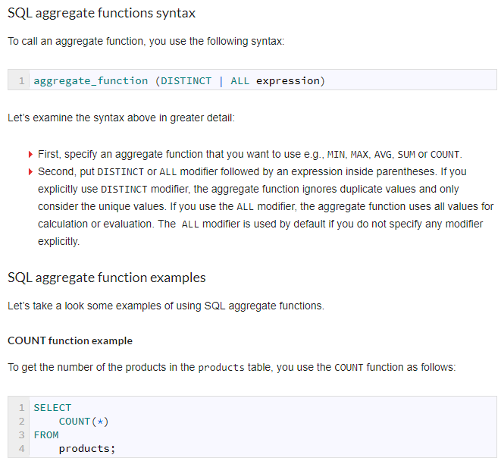
http://www.zentut.com/sql-tutorial/sql-aggregate-functions/

Slide 17
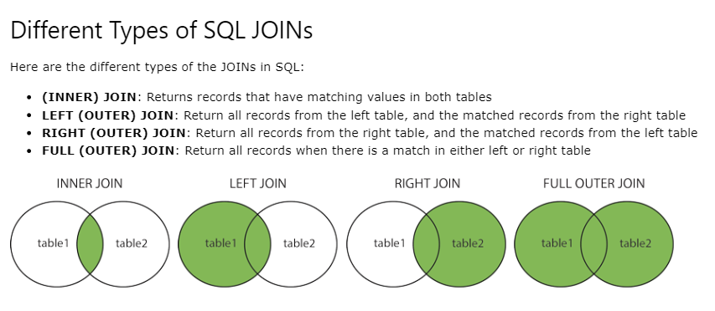

Slide 18
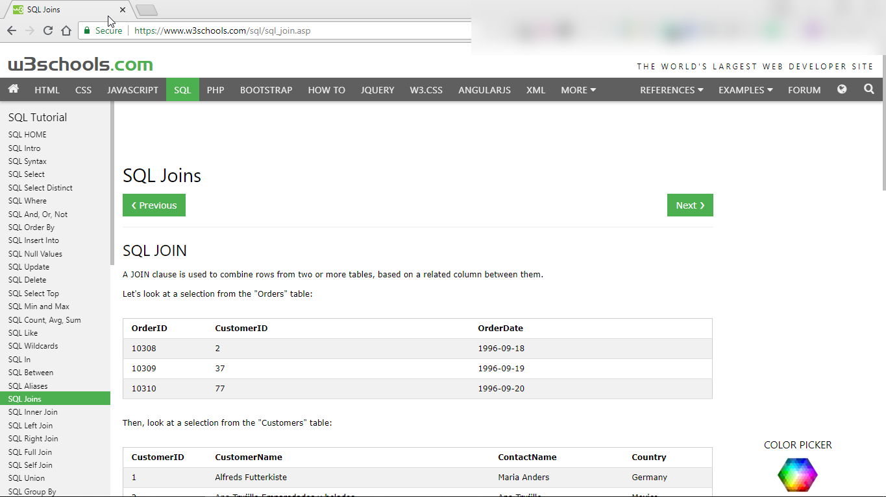

Slide 19
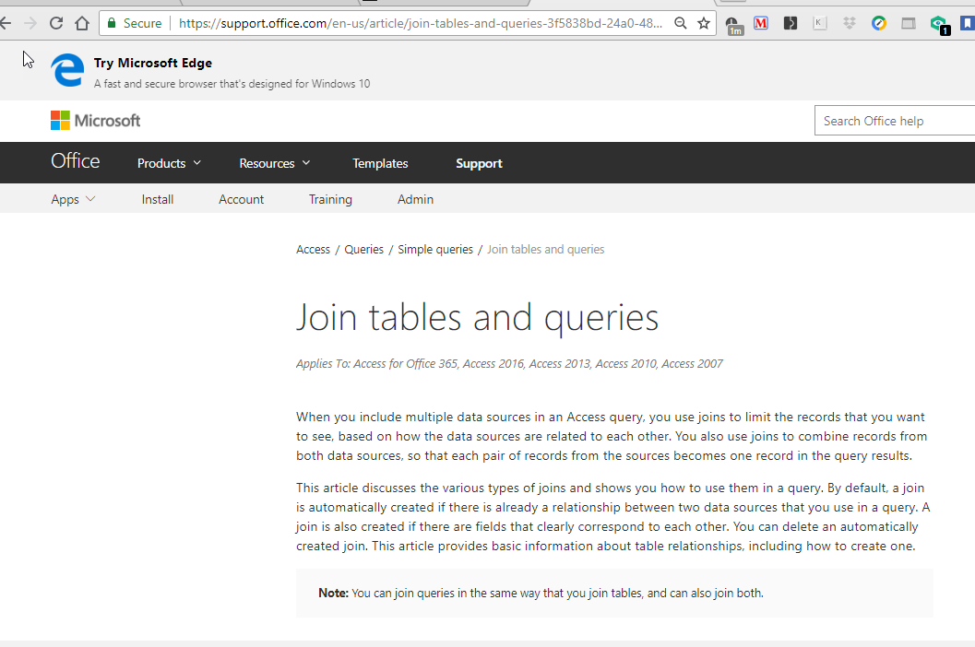
https://support.office.com/en-us/article/join-tables-and-queries-3f5838bd-24a0-4832-9bc1-07061a1478f6

Slide 20
WORKSHEET FOR DATABASE PROJECT DELIVERABLE:
Write 3 SQL Statements:
Generate a Report on all customers including bicycles they have purchases or brought in for repair: LEFT_JOIN_2
SELECT c.cellphone, c.name, c.city, c.occupation, p.cellphone,
p.bicycle_id_number, p.purchase_date, r.date_in, r.charge, r.cellphone
FROM ( ( customers AS c )
LEFT JOIN purchase_records AS p ON c.cellphone = p.cellphone )
LEFT JOIN repair_data AS r ON c.cellphone = r.cellphone

Slide 21
WORKSHEET FOR DATABASE PROJECT DELIVERABLE:
Write 3 SQL Statements:
Generate a Report on all Bicycles purchased or brought in for repair:
INCLUDING THE REPAIR DETAILS AND THE CUSTOMER DETAILS.

Slide 22
WORKSHEET FOR DATABASE PROJECT DELIVERABLE:
Write 3 SQL Statements: ‘REPAIR_DEPARTMENT_ACTIVITIES’
Generate a Report on the activities of the Repair Department: How many bicycles they have repaired, time spent, and revenue generated.
How will you know to report ZERO DOLLARS for repairs done when the bicycle was purchased at our Shop?
WE WILL NEED TO DO THIS AS A LEFT JOIN: COMPLETE THE DETAILS HERE BASED ON YOUR PREVIOUS WORK:

Slide 23
USING THIS TEMPLATE, COMPLETE THE SQL CODE TO DO THE LEFT JOIN OF REPAIR DATA WITH PURCHASE RECORDS:
SELECT customers.name, purchase_records.purchase_date
FROM customers
LEFT JOIN purchase_records ON customers.cellphone = purchase_records.cellphone;

Slide 24
SELECT c.cellphone, c.name, c.city, c.occupation, p.cellphone, p.bicycle_id_number, p.purchase_date, r.date_in, r.charge, r.cellphone
FROM (customers AS c LEFT JOIN purchase_records AS p
ON c.cellphone = p.cellphone)
LEFT JOIN repair_data AS r ON c.cellphone = r.cellphone;

Slide 25
SELECT CategoryName,
ProductName
FROM Categories LEFT JOIN Products
ON Categories.CategoryID = Products.CategoryID;

Slide 26
How to create a New Table from a SQL Query
SELECT a,b,c INTO NewTable
FROM
(SELECT a,b,c
FROM TheTable
WHERE a Is Null)

Slide 27
SELECT sum(aaa.charge) as Revenue, count(aaa.charge) as NumberCustomers, customers.city
FROM aaa, customers
where customers.cellphone = aaa.cellphone
group by city
Notes:
Query_table_aaa

Slide 28
Repair data report
SELECT repair_data.cellphone,
purchase_records. purchase_date, repair_data.charge, repair_data.bike_id, repair_data.date_out
FROM repair_data
LEFT JOIN purchase_records
ON repair_data.cellphone = purchase_records.cellphone

